Slide 1

Sit Down & Stand Out
Adaptive Sports Equipment Recommendations for Seated Athletes
Brought to you by
The NDVWSC Seating & Prosthetics Team

Slide 2
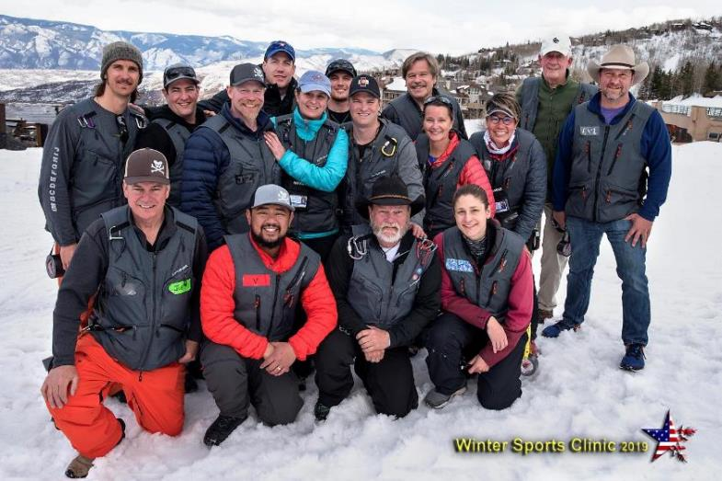
WSC Seating & Prosthetics Team

Slide 3
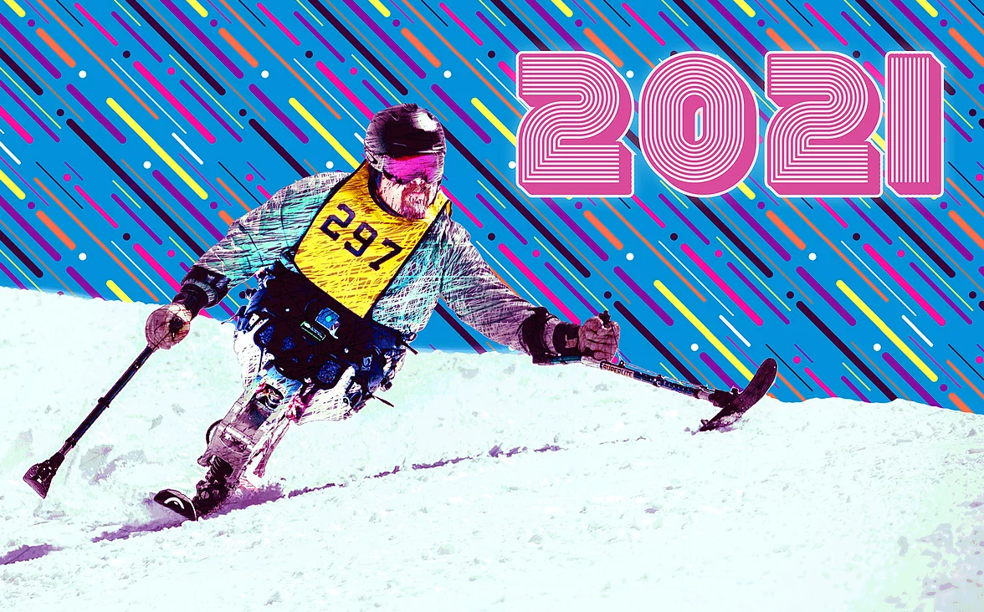
Your Hosts
Kendra Betz
Joe Bieganek
Chad Kincaid
Brent King

Slide 4
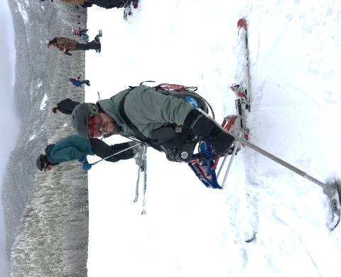
OBJECTIVES
Upon completion of the session, participants will be able to:
Identify three priorities for seating interventions applied to sports and recreation equipment.
Discuss two reasons that skin protection is necessary for the seated athlete.
Describe when a custom seating system is recommended for adaptive sports equipment.

Slide 5
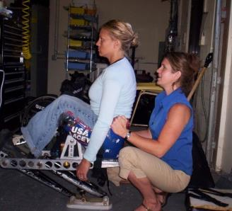
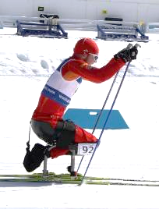
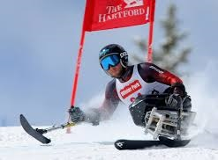
What is Seating?
Seating for Sports helps with . . .
Skin Protection
Postural stability
Dynamic movement
Injury prevention
Sport performance
Comfort

Slide 6
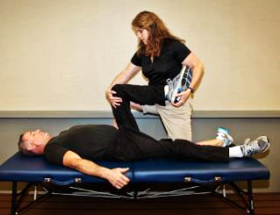
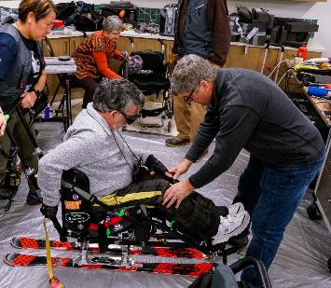
Seating / Technology/ Boot Fit Clinic
Veterans with their own adaptive sports equipment who need adjustments.
Veterans with current or prior challenges with skin protection and/or sitting posture and support.
Experienced athletes trialing new equipment.
Those participating in sports with a prosthetic limb.
We work with the Veteran and their doctors, therapists, coaches & instructors.

Slide 7
PT & OT
Medical
Providers
Rec Therapy
Athlete
with a
Disability
O & P
W/C & Seating
SME
Adaptive Programs
Vision Hearing
Cognition
Coaches /
Instructors
Cognition/
Mental Health
Industry
Experts

Slide 8
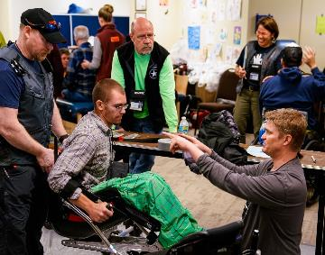
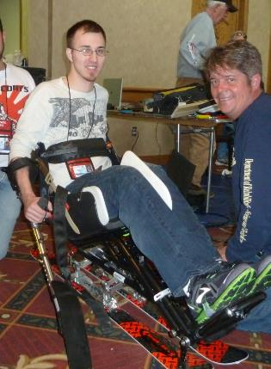
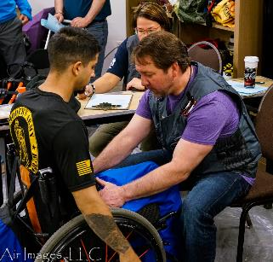
Athlete Evaluation – Dry Land
Comprehensive review
  Body size and shape
  Range of motion
  Strength
  Tone / Spasticity
  Posture
  Skin
  Balance
  Coordination
  Functional skills

Slide 9
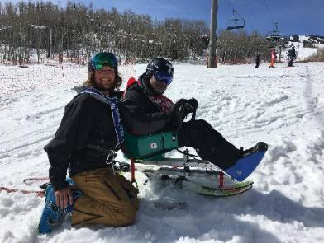
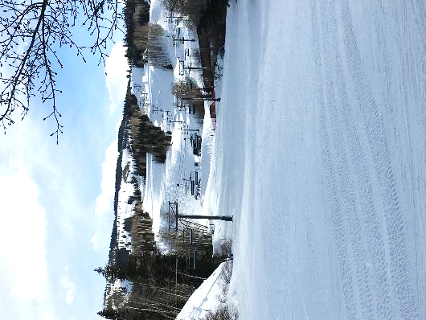
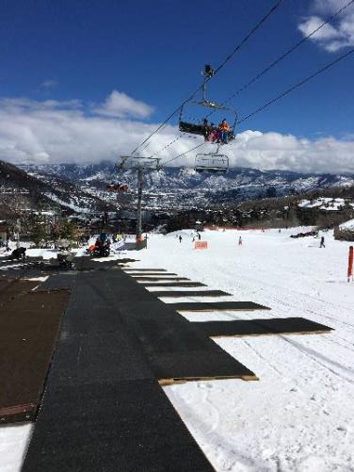
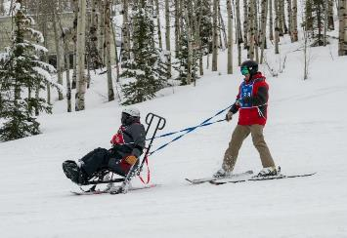
Slopeside @ NDVWSC

Slide 10
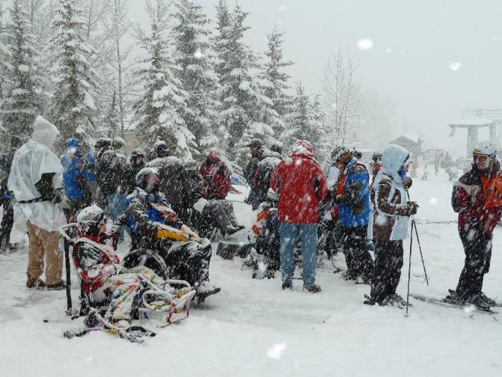
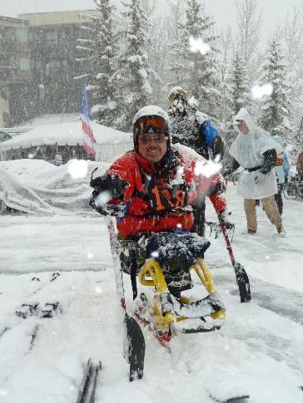
Anything goes with Colorado weather ☺

Slide 11
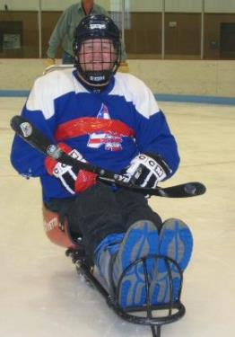
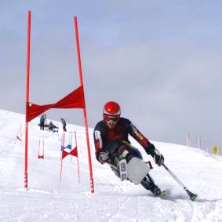
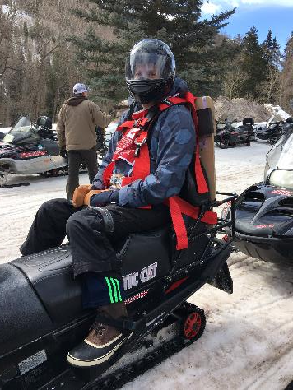
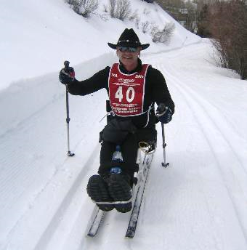
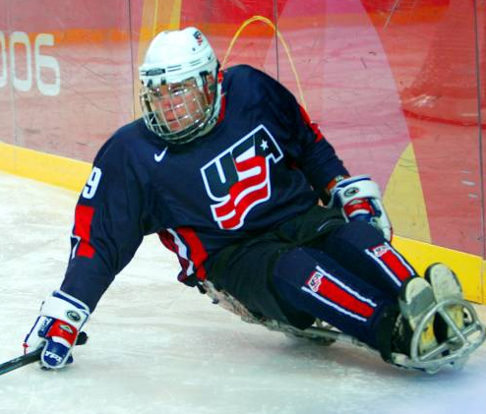
Seating in Action!

Slide 12
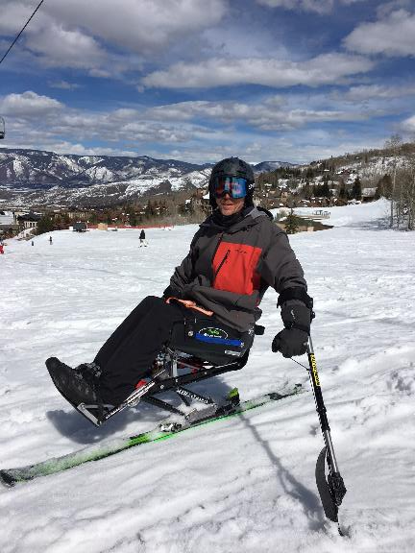
Custom Seating Considerations
Indications & Considerations
  Competition and/or considering racing
      *** NOT a requirement
  Avid / consistent participation
  Skin challenges - current or past
  Significant postural deformity
  Significant range of motion limitations
  Limb Loss
    High bilateral transfemoral amputations
    Hip disarticulation(s)

Slide 13
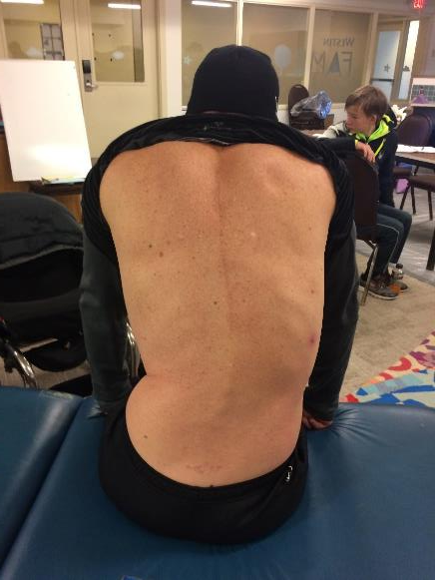
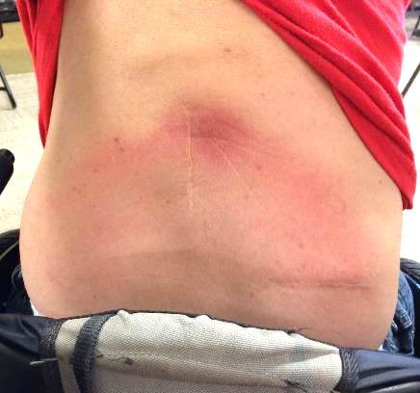
Posture + Skin Challenges

Slide 14
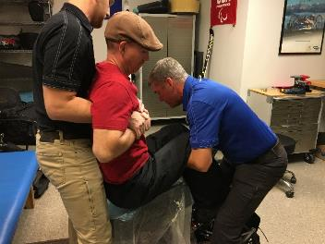
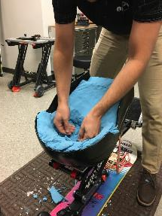
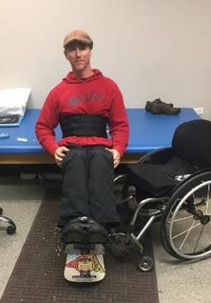
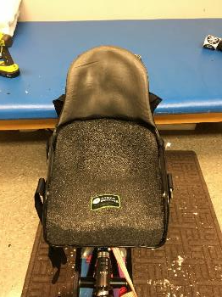
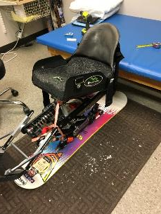
Custom Seating

Slide 15
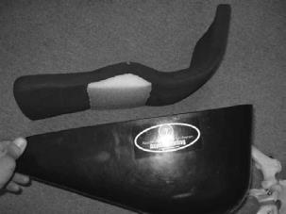
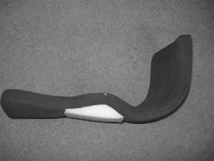
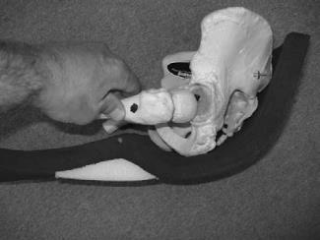
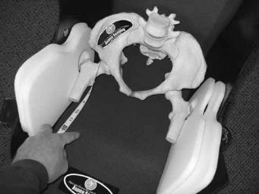
Off-the-shelf options
“Fit-Kit” by Aspen Seating

Slide 16
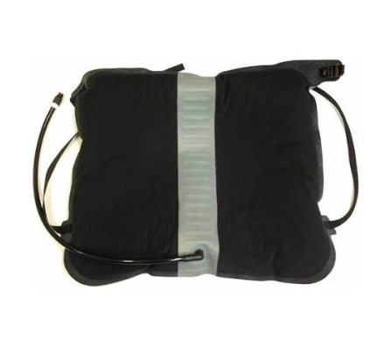
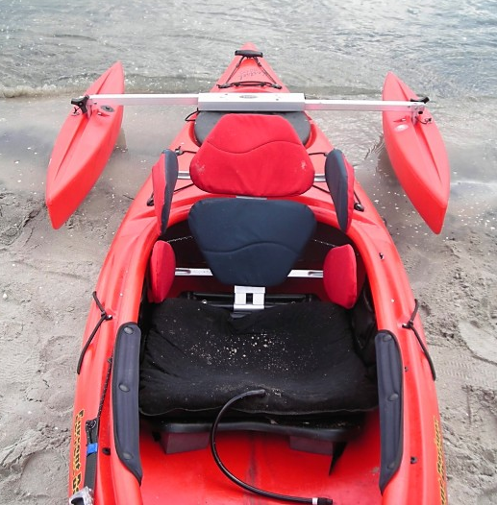
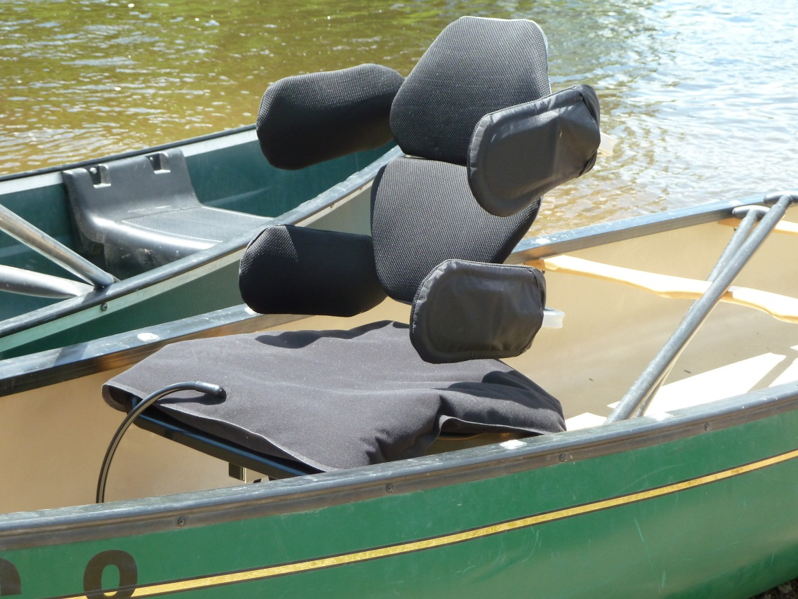
Off-the-shelf options
“Sweet Cheeks ” by Jackson Kayaks

Slide 17
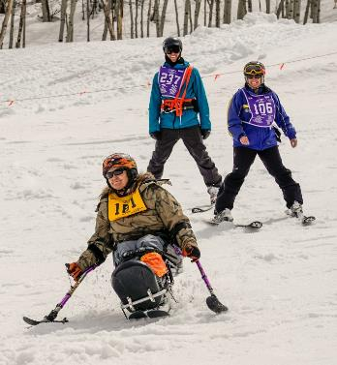
Pursuing Your Own Adaptive Sports Equipment
Recommended minimum requirements
  Independent intermediate runs
  Independent load & off-load lift
  Independent up from a fall
  Skiing consistent & frequent
  Equipment trials complete
  AND / OR
  Unique seating needs

Slide 18


To love what you do and feel that it matters, how could anything be more fun?
~ Catherine Graham
Thank You!
Kendra Betz
Joe Bieganek
Chad Kincaid
Brent King

Slide 19
References
Gabison S, Mathur S, Nussbaum E, Popovic M, Verrier M. The relationship between pressure offloading and ischial tissue health in individuals with spinal cord injury: An exploratory study. Journal of Spinal Cord Medicine. 2019. 42; 186-95.
Nace S, Tiernan J, Annaidh A. Manufacturing custom-contoured wheelchair seating: A state-of-the-art review. Prosthetics and Orthotics International. 2019. 43(4); 382-395.
Sonenblum S, Seol D, Sprigle S, Cathcart, J. Seated buttocks anatomy and its impact on biomechanical risk. Journal of Tissue Viability. 2020. 29; 69-75.

